Slide 1

Masked ANXED
Mentors : JerNettie Burney
Joshua Kissel
Michaud Reyna
Johnny Turner
Chinedu Chidinma

Slide 2
Unmasking the Sentiment !
The COVID-19 pandemic, resulting economic decline, and unprecedented curbs on social interactions have negatively affected many people’s mental health and created new angles of discomfort for people already suffering from mental health and substance use disorder.
Using the vast amount of data that’s been collected internationally over the last year we have a “natural” opportunity/experiment , in how policies in different countries impact mental health as well as if certain demographics, genders, or minority groups were affected differently .

Slide 3
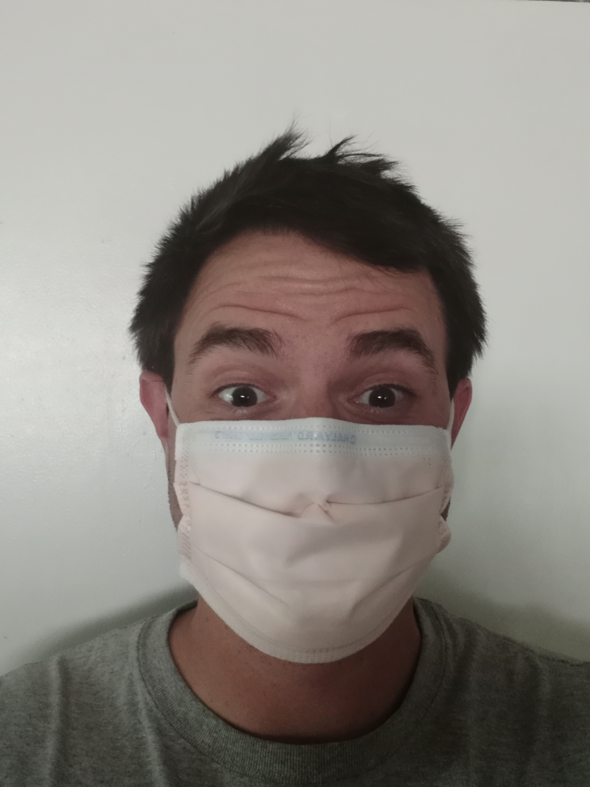

Team Members – Mentors
Joshua Kissel
JerNettie Burney

Slide 4
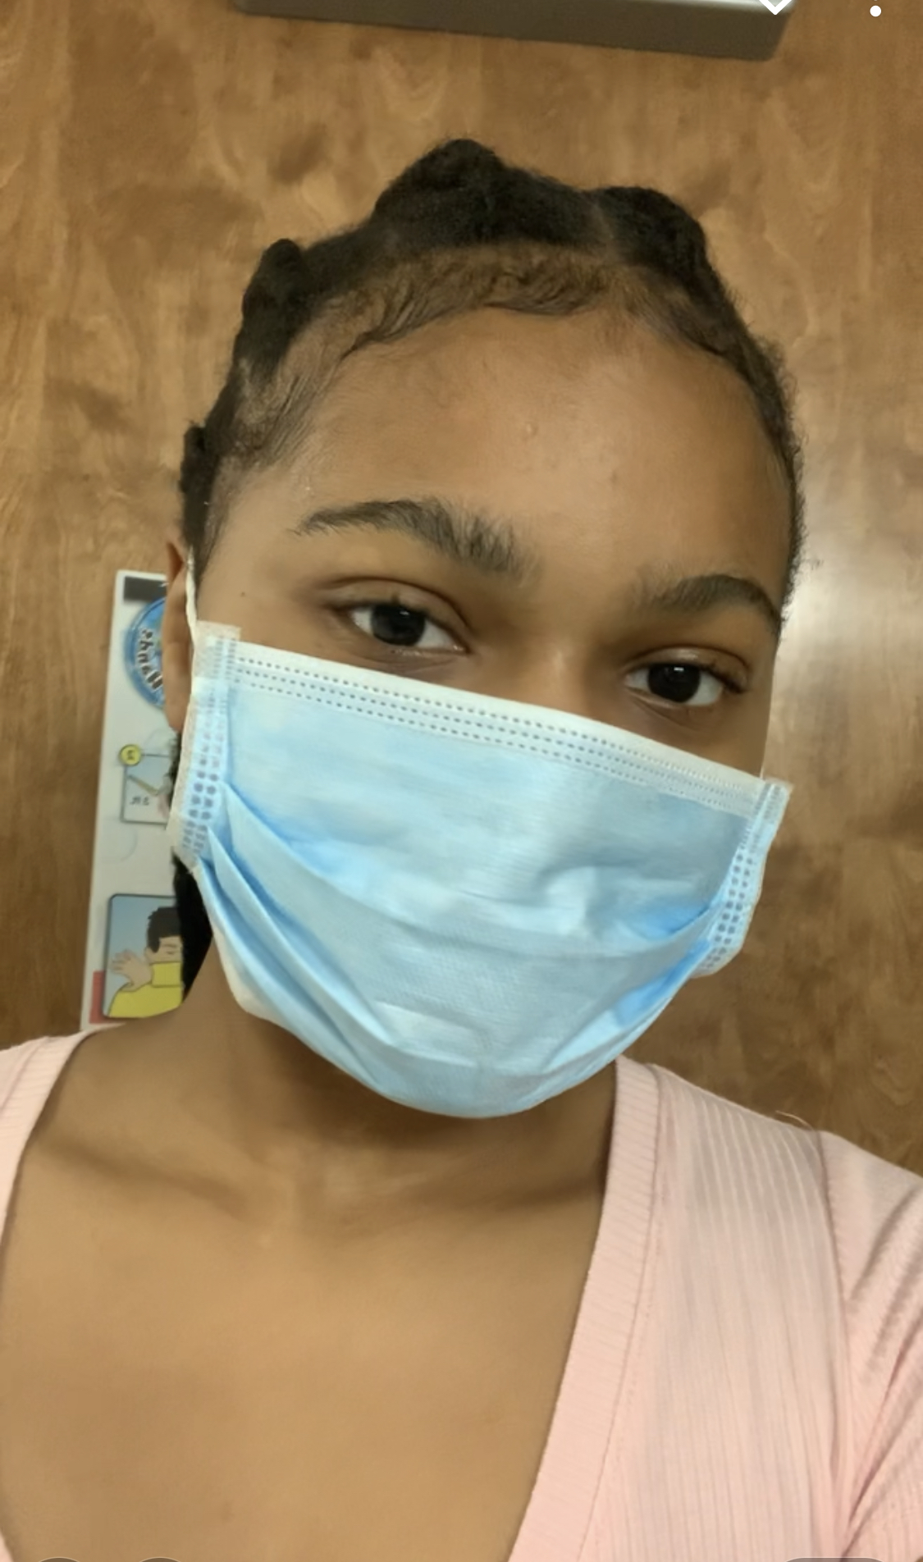
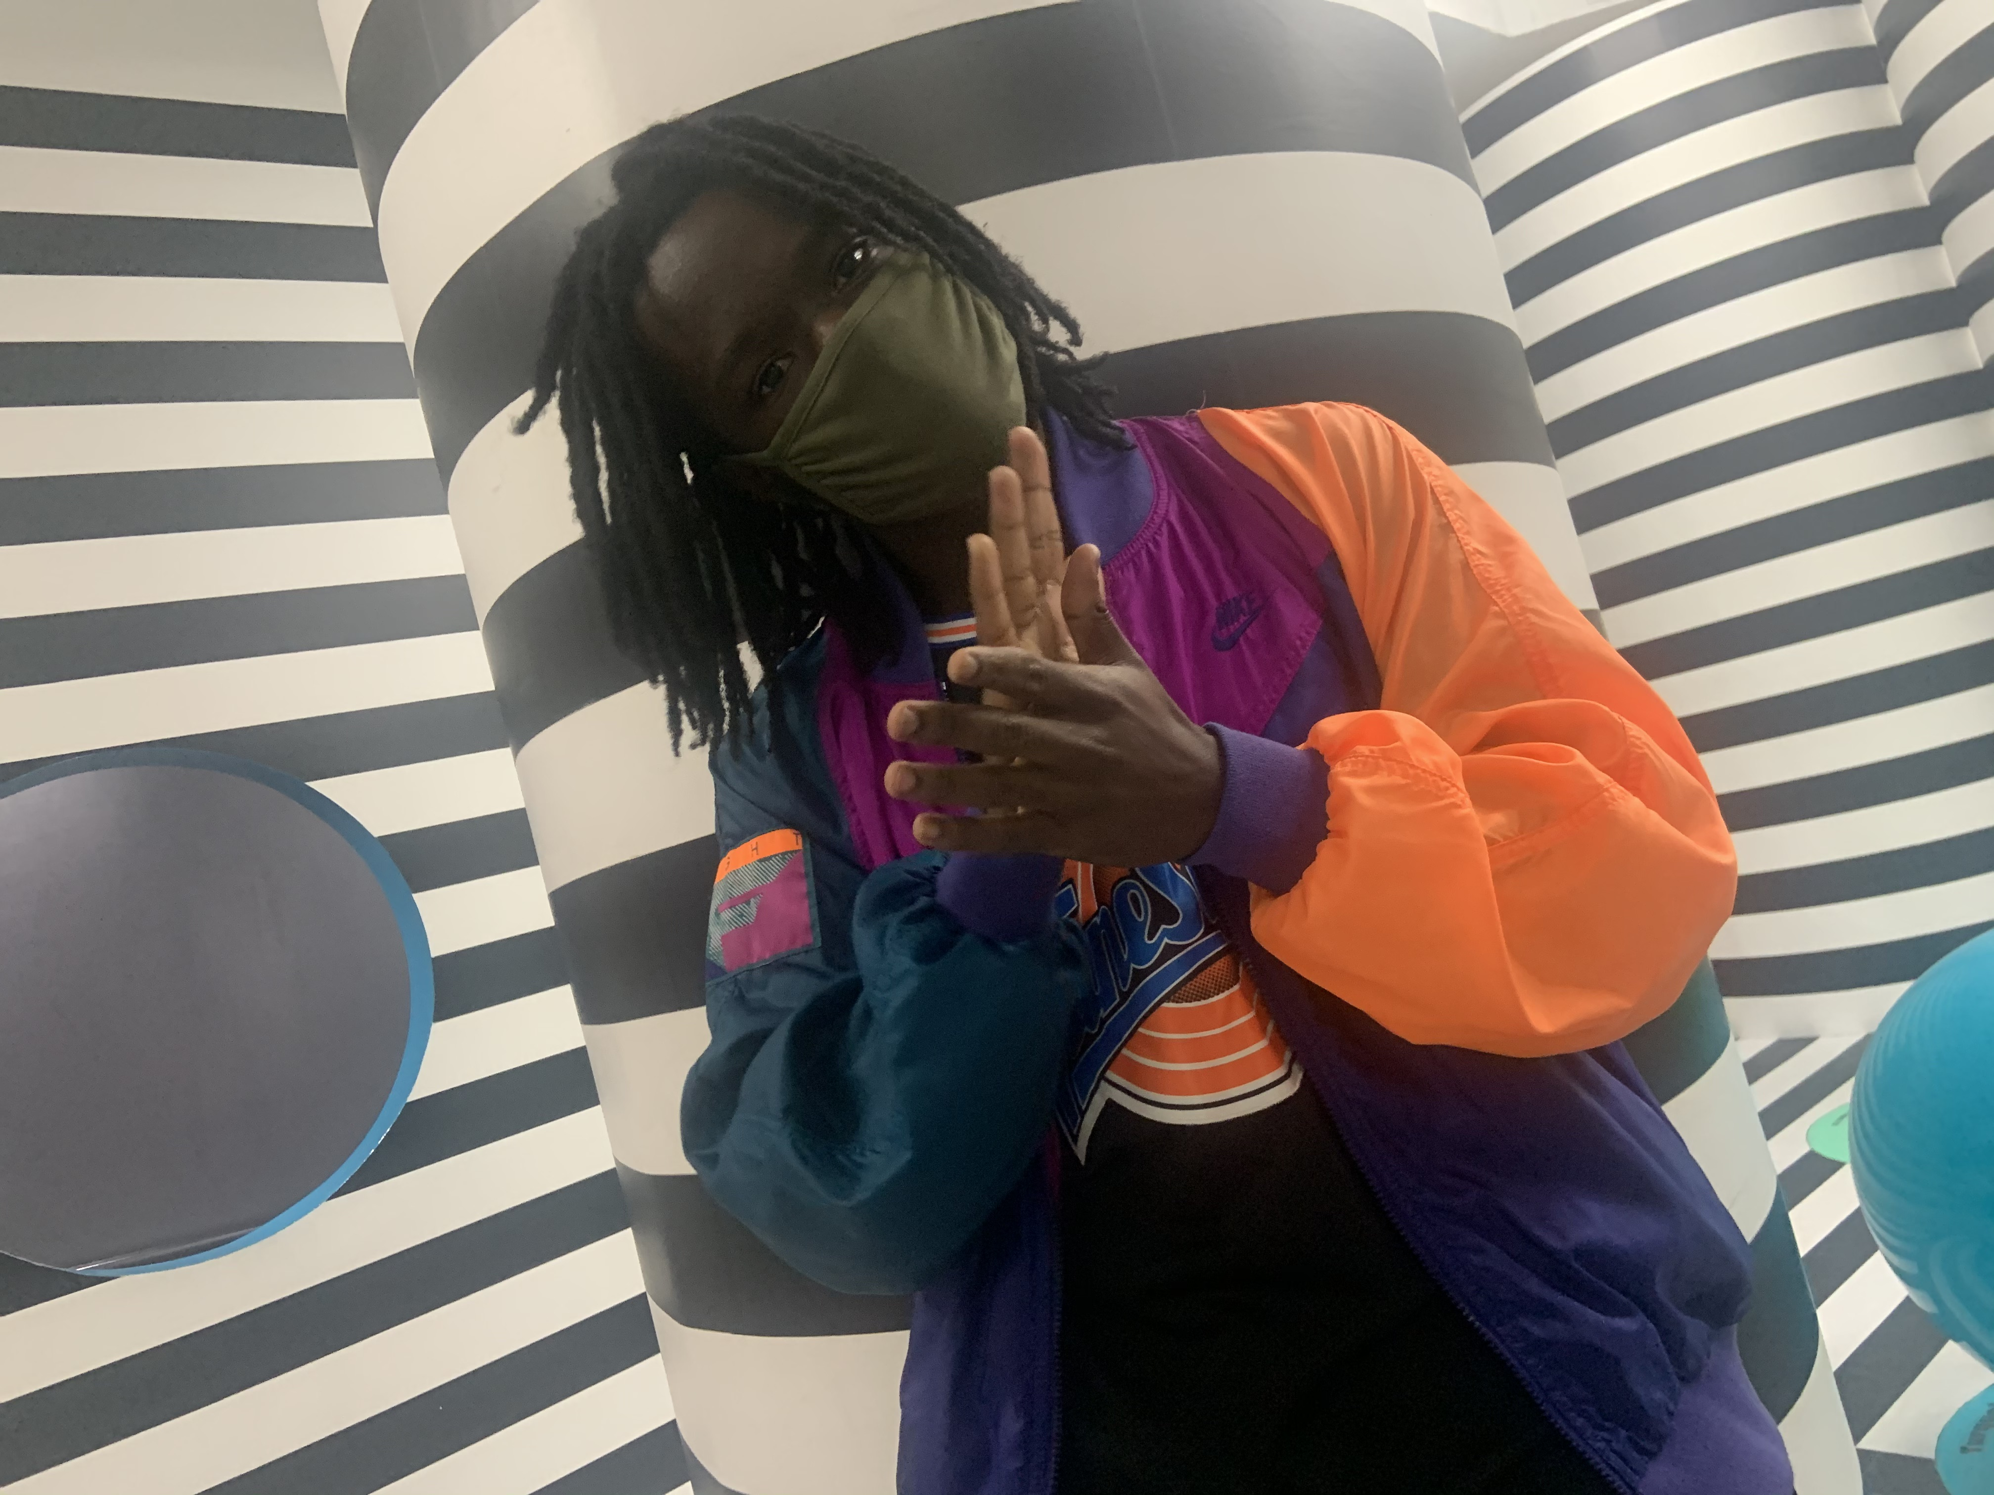
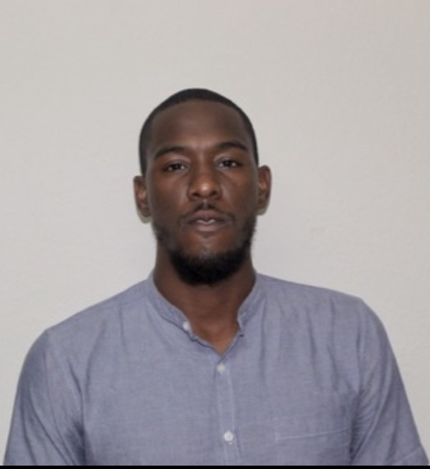
Team Members – Students
Chinedu Chidinma
Johnny Turner
Michaud Reyna

